Slide 1
Edge Detection in Verilog
Thomas Kelly, Hamed Rastaghi, Xiteng Yao, Shining Yang

Slide 2
Table of Contents
Review of project
Detailed breakdown
Understanding module by module
Examples of processed images
Successes
Shortcomings/What’s Left

Slide 3
Goals
Perform edge detection in Verilog
Send an image through the UART port byte-by-byte
The image is processed in a streamlined fashioned
The image is not rebuilt until the final output
Save on memory and speed compared to alternative implementations

Slide 4
High-Level Functionality
Building the Bytes
Python Transmitter and Receiver
UART
Extract Data
UART
Detect Edges
Output files
Display

Slide 5
Specification of the Edge Detector
Performance Requirement
Sobel edge detector module shall process 1 byte per cycle
UART modules shall send/receive 1 bit per 10 cycle, can be shorter if HW allows
Image Size
Variable sized image accepted
Image size up to 1000 X 1000, can be increased if HW allow
Image Type
Need to be able to accept RGB images
Possibly support continuous processing of images
Tradeoff
The higher the resolution, the more memory will be used, and more processing time will be needed

Slide 6
More Comprehensive Block Diagram
16
/
height
/
16
width
Transmitter
Receiver
Parser
/
8
RGB2Gray
/
8
/
8
/
8
/
8
Rom Block
Receiver
Transmitter
VGA
Sobel
/
8
Display
←Python
Verilog→

Slide 7
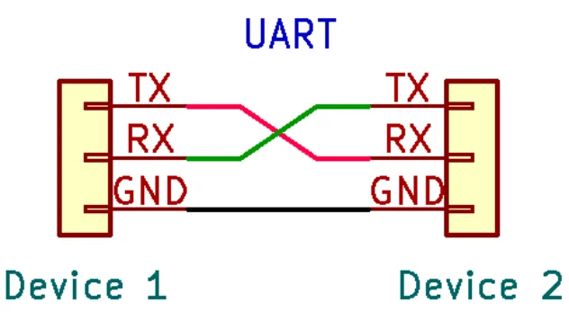
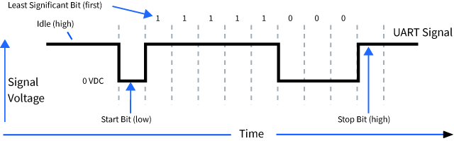
UART Basics - Xiteng
Universal Asynchronous Receiver / Transmitter
A serial connection between two devices to transfer data
TX for transmitting, RX for receiving
Work together with preset baud rates and frequencies
UART signals have a special pattern

Slide 8
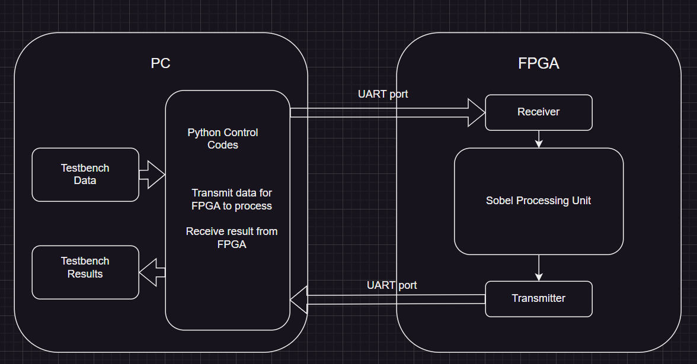
UART In Our Project - Xiteng

Slide 9
UART on the PC side - Xiteng
We wrote several Python scripts to read the images from a folder, and send it to the UART port one by one
Each file is processed independently
The images can be processed as grayscale or RGB
Also includes necessary metadata for the Sobel algorithm to use
Enables frame by frame processing for videos

Slide 10
UART on the FPGA side
Receiver (Tom)
Idle state: waiting for the logic-low start bit
Sampling state: sample each of the bits in the middle
Cleanup state: once the logic-high end bit is received, prepare for transmission of next byte
Clock frequency is much higher than the baud rate, and their relationship is key
Transmitter (Xiteng)
5-State state machine
Detects when one byte of data is processed
Send it to the PC when data available
Speed is limited because only one bit can be transmitted at a time
Already tested on simulation and lab FPGAs

Slide 11
Parser (Tom)
For a variable height and width, Sobel must learn these values before performing any processing
The RGB2Gray module must receive all 3 values simultaneously, even though they are transmitted sequentially through UART
Red
Blue
Green
Red
Width 1
Width 0
Height 1
Height 0
Store
Red
Green
Blue

Slide 12
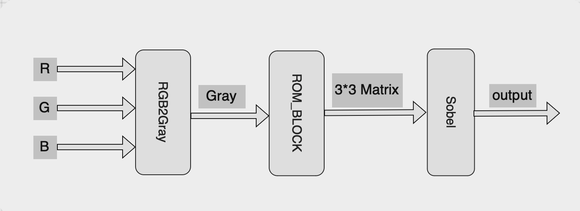
Algorithm(Hamed)
RGB2gray module is streamlined
There is a Rom Block between RGB2gray and Sobel

Slide 13
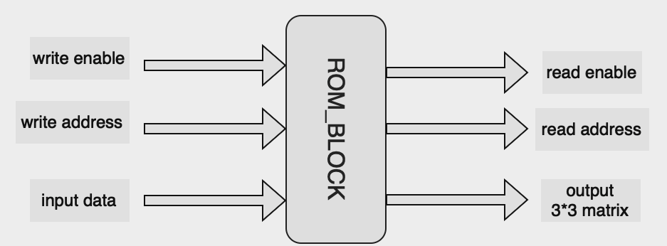

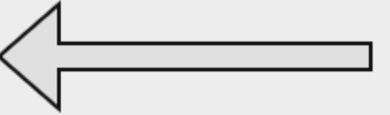
Rom Block(Hamed)

Slide 14


Sobel(Hamed)
Here A is the source image.(a text file with all pixel values in it)
Gx: Horizontal derivative approximations
Gy: Vertical derivative approximations
G: Processed image

Slide 15
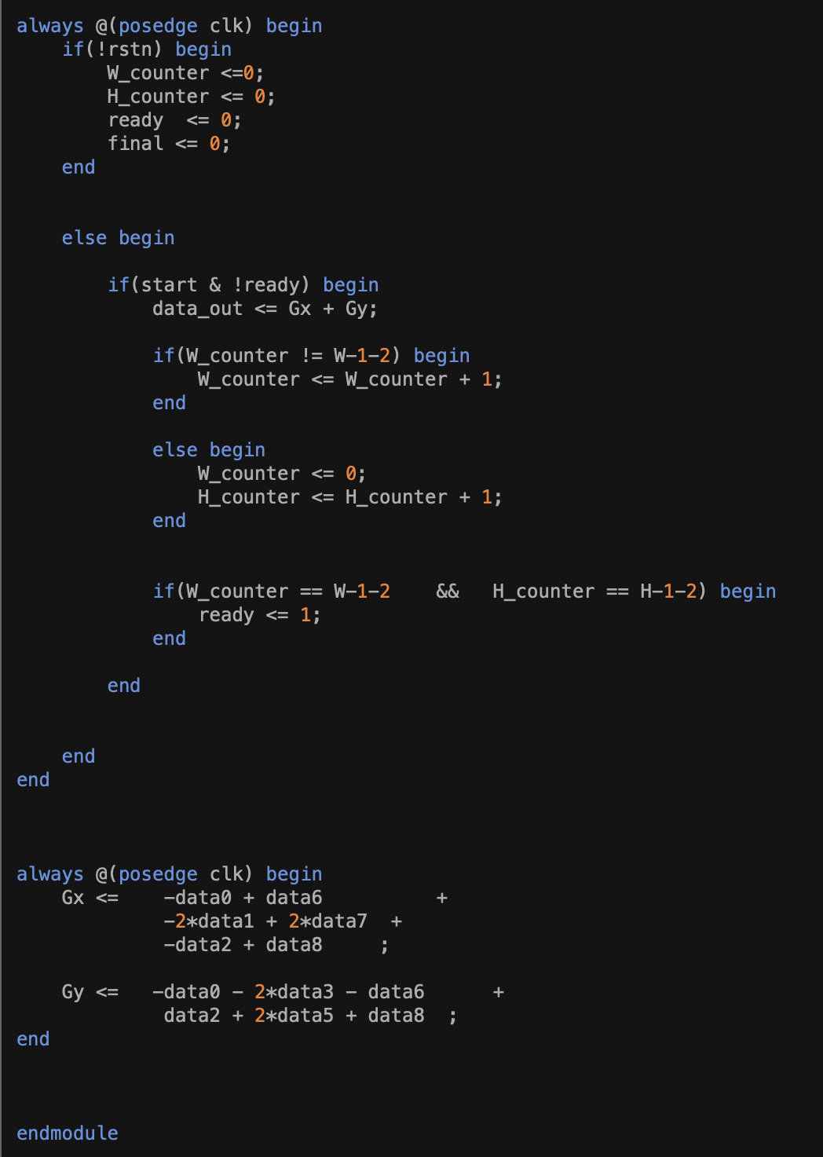
Sobel(Hamed)

Slide 16
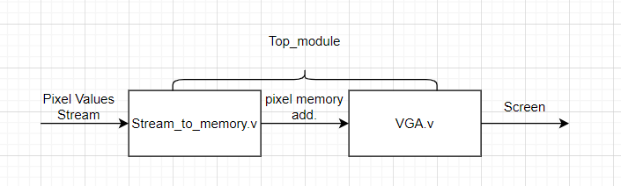
Memory-VGA-Screen
We firstly store the pixel stream in a memory block, then output the pixel values to VGA.v
Buffering and Synchronization
Data Manipulation
Error Handling and Test

Slide 17
Memory-VGA-Screen
Stream-to-memory module
Input wire [x:0] address, x depends on size of the image
(We assign the address values in the top module)
Input [3:0] data_in : This is the stream of pixels
Output [3:0] data_out [y:z] , y,z depend on the size of the image
VGA module
Input [3:0] data_in [y:z]
output reg [3:0] red
output reg [3:0] green
output reg [3:0] blue
output reg hsync, vsync

Slide 18
VGA Module(For 640*480 Resolution)
HSYNC VSYNC: signals used for synchronizing the display of image data on a monitor.
HSYNC Functioning: When a line of pixels (a row) is finished being displayed, the HSYNC signal tells the display to move the beam back to the left side of the screen to start displaying the next line.
To let the image shown on screen is grayscale, we need to assign the grayscale pixel value (0-255) to all Red, Green and Blue ports.

Slide 19
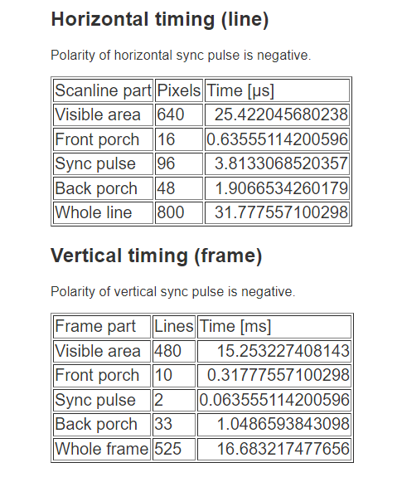
VGA Module
assign HSYNC = (h_counter < (active_h_pixels + front_porch_h_pixels)) || (h_counter >= (active_h_pixels + front_porch_h_pixels + sync_pulse_h_pixels));
assign VSYNC = (v_counter < (active_v_lines + front_porch_v_lines)) || (v_counter >= (active_v_lines + front_porch_v_lines + sync_pulse_v_lines));
For different resolution, we need to make a adjustment

Slide 20
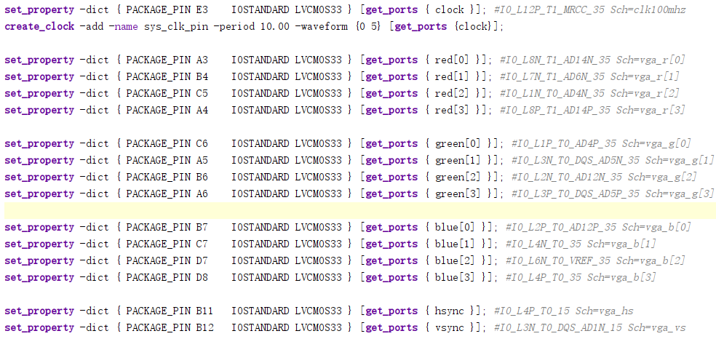
Constraints

Slide 21
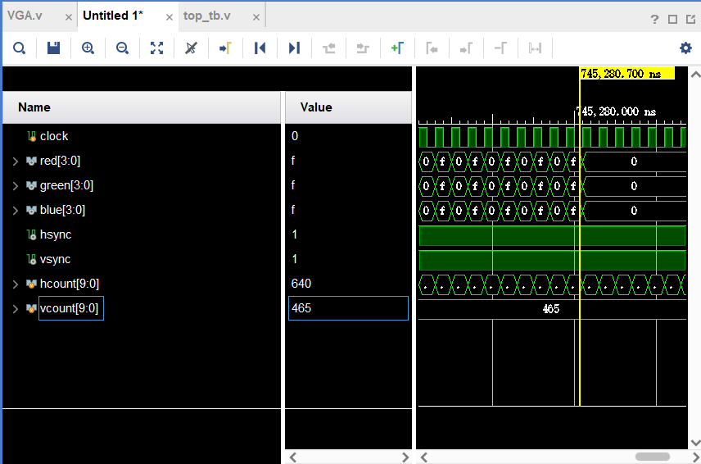
VGA Simulation Result

Slide 22
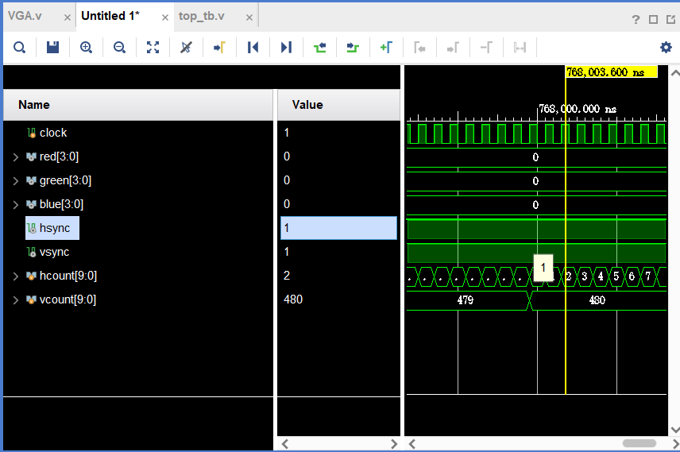
VGA Simulation Result

Slide 23
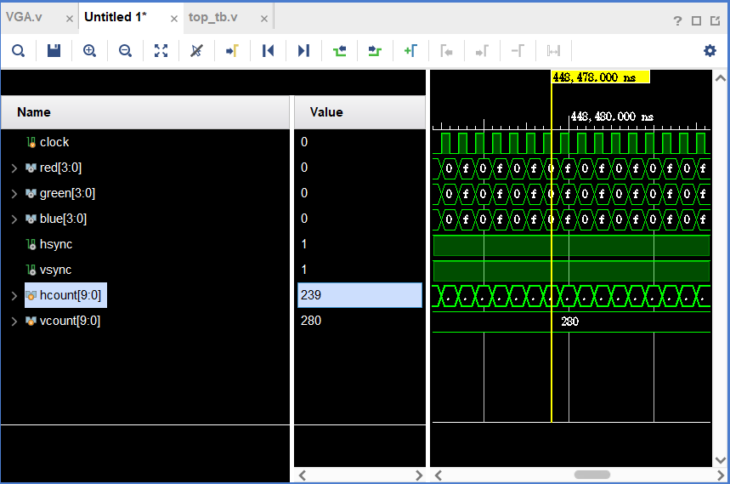
VGA Simulation Result

Slide 24

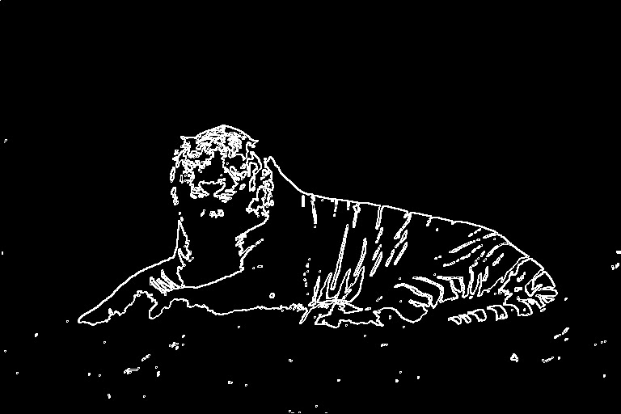
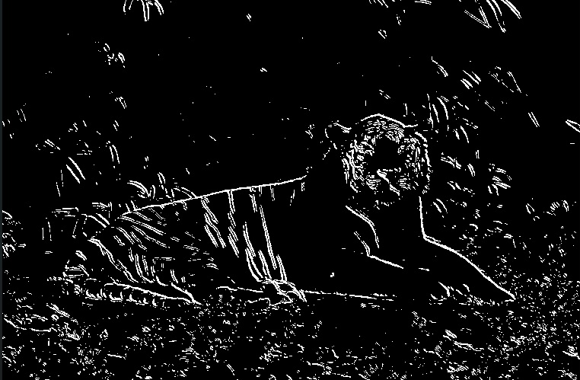
DetectoVision
Edge Detectors

Slide 25
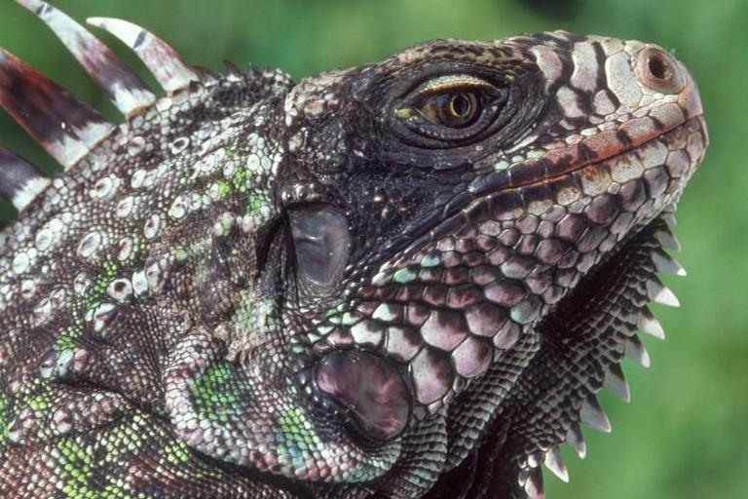
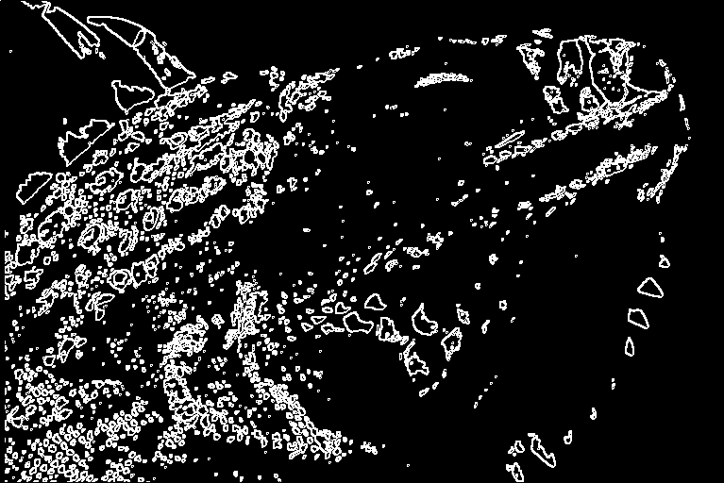
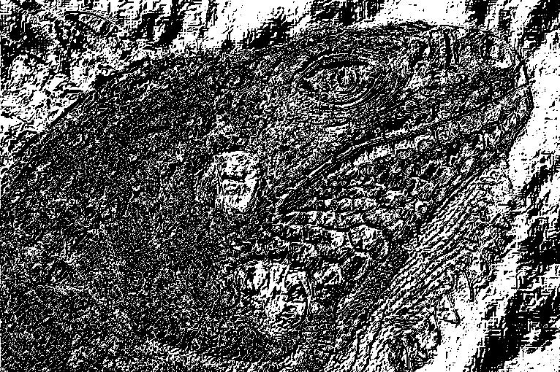
DetectoVision
Edge Detectors

Slide 26
Successes
Running the entire pipeline without using the FPGA
Constructed two simulations of the entire pipeline using Vivado
The simulations can emulate the UART communication between PC and FPGA
The simulation takes an image as input and outputs the processed image back to the PC using UART
The images above were obtained this way

Slide 27
Shortcomings/What’s Left
The current version of Sobel stores the image, we are working to not have to rebuild the image until the final output
The threshold of the sobel filter still needs adjustment
We will add a switch to the algorithm so that the user can adjust the sensitivity of the algorithm(threshold) by changing the switch on the FPGA
There is still a possibility for video
We have not yet actually implemented this on an FPGA (sprinklers)

Slide 28
References
https://www.youtube.com/watch?v=sTHckUyxwp8
https://www.secureideas.com/blog/hardware-hacking-finding-uart-pinouts-on-pcbs
https://www.digi.com/resources/documentation/Digidocs/90001541/reference/r_serial_data.htm?TocPath=Serial%20communication|_____2
https://www.chipverify.com/verilog/verilog-file-io-operations
https://www.edaboard.com/threads/writing-values-of-a-variable-to-a-file-using-verilog-hdl.209993/

